Slide 1

Descriptive Epidemiology

Slide 2
Propagated is person to person transmission. Gonorrhea is sexually transmitted infection, and it can continue to spread if the common source is not treated or protected in case of multiple sexual partners or FSW. It becomes intermittent common source epidemic .
Also, at times a person who contracts syphilis can spread to their partner in the absence of safe practices and becomes propogated.
If restricted to only one partner, it becomes the end source. If they have multiple then the propagation continues.
It can be considered as a mixed epidemic
https://www.cdc.gov/csels/dsepd/ss1978/lesson1/section11.html

Slide 3
MCQ - 1
1. Which of the following is characteristic of a single exposure common vehicle outbreak?
a. Frequent secondary cases
b. Severity increases with age
c. Explosive
d. Cases occur continuously beyond the longest Incubation period

Slide 4
MCQ - 2
2. True about Point source Epidemic is
a. Occurs in more than one incubation period
b. Occurs in one incubation period
c. The exposure is continuous
d. Epidemic curve falls very slowly.

Slide 5
MCQ - 3
3.Which of the following study design has population as unit of study
a. Case - control
b. Cohort
c. Cross - sectional
d. Ecological study

Slide 6
MCQ - 4
4. True about continuous common source Epidemics.
a. High SAR
b. Duration more than One Incubation period
c. Rapid rise and fall of Epidemic curve
d. Brief and simultaneous exposure

Slide 7
MCQ - 5
5. An Epidemic of Hepatitis A is an example of
a. Common source, Single exposure epidemic
b. Common source, Continuos exposure epidemic
c. Propagated Epidemic
d. Slow Epidemic

Slide 8
MCQ - 1
What does the term "secular trend" in epidemiology refer to?
A) Short-term fluctuations in disease occurrence over a specific period of time.
B) Progressive increase or decrease in disease occurrence over a long period of time.
C) Random variations in disease patterns without any consistent direction.
D) Changes in the age distribution of diseases over a specific timeframe.

Slide 9
MCQ - 2
Which of the following diseases is likely to shows a seasonal trend?
A) Dengue fever
B) Hypertension
C) Diabetes mellitus
D) Osteoarthritis

Slide 10
MCQ - 3
Among the following diseases, which one demonstrates a combination of both a cyclic trend and a seasonal trend?
A) Measles
B) Tuberculosis
C) Malaria
D) None of the above

Slide 11
MCQ -4
The study of the geography of disease in descriptive epidemiology helps us understand:
A) The uniformity of disease patterns between countries.
B) The impact of genetics on disease occurrence.
C) The variations in disease patterns within and between countries.
D) The effectiveness of migration in reducing disease incidence.

Slide 12
MCQ - 5
The study of the geography of disease in descriptive epidemiology helps us understand:
A) The uniformity of disease patterns between countries.
B) The impact of genetics on disease occurrence.
C) The variations in disease patterns within and between countries.
D) The effectiveness of migration in reducing disease incidence.

Slide 13
Place distribution
Studies of the geography of disease (or geographical pathology) is one of the important dimensions of descriptive epidemiology.
Perspective on the fascinating differences (or variations) in disease patterns not only between countries, but also within countries.
The relative importance of genes versus environment;
Changes with migration
Possible roles of diet
Geographic patterns provide an important source of clues about the causes of the disease.
The range of geographic studies include those concerned with local variations. At a broader level, international comparisons may examine mortality and morbidity in relation to socio-economic factors, dietary differences and the differences in culture and behaviour. These variations may be classified as :
International variations
National variations
Rural Urban Variation
Local distributions

Slide 14
International variations
Pattern of disease is not the same everywhere.
Marked difference between the incidence of each cancer in different parts of the world.
Cancer of the stomach is very common in Japan, but unusual in US.
Cancers of the oral cavity and uterine cervix are exceedingly common in India as compared to industrialized countries.
An International study of breast cancer showed that rates differ widely from country to country with the lowest prevalence in Japan and the highest in the western countries.
Similarly, there are marked international differences in the occurrence of cardiovascular diseases.
These variations have stimulated epidemiologists to search for cause-effect relationships between the environmental factors and disease.

Slide 15
National Variations
The distribution of endemic goitre, lathyrism, fluorosis, leprosy, malaria, nutritional deficiency diseases have all shown variations in their distribution in India, with some parts of the country more affected and others less affected or not affected at all.
Such situations exist in every country.
Such information is needed to demarcate the affected areas and for providing appropriate health care services.

Slide 16
Rural Urban Variations
Chronic bronchitis, accidents, lung cancer, cardiovascular diseases, mental illness and drug dependance are usually more frequent in urban than in rural areas.
On the other hand, skin and zoonotic diseases and soil-transmitted helminths may be more frequent in rural areas than in urban areas.
Death rates, especially infant and maternal mortality rates, are higher for rural than urban areas.
These variations may be due to differences in population density, social class, deficiencies in medical care, levels of sanitation, education and environmental factors.
The epidemiologist seeks to define groups which are at higher risk for particular diseases and provides guidelines to the health administrator for their prevention and control.

Slide 17
Local Distributions
These variations are studied with the aid of ‘spot maps’ or ‘shaded maps’.
These maps show at a glance areas of high or low frequency, the boundaries and patterns of disease distribution.
If the map shows “clustering” of cases, it may suggest a common source of infection or a common risk factor shared by all the cases

Slide 18
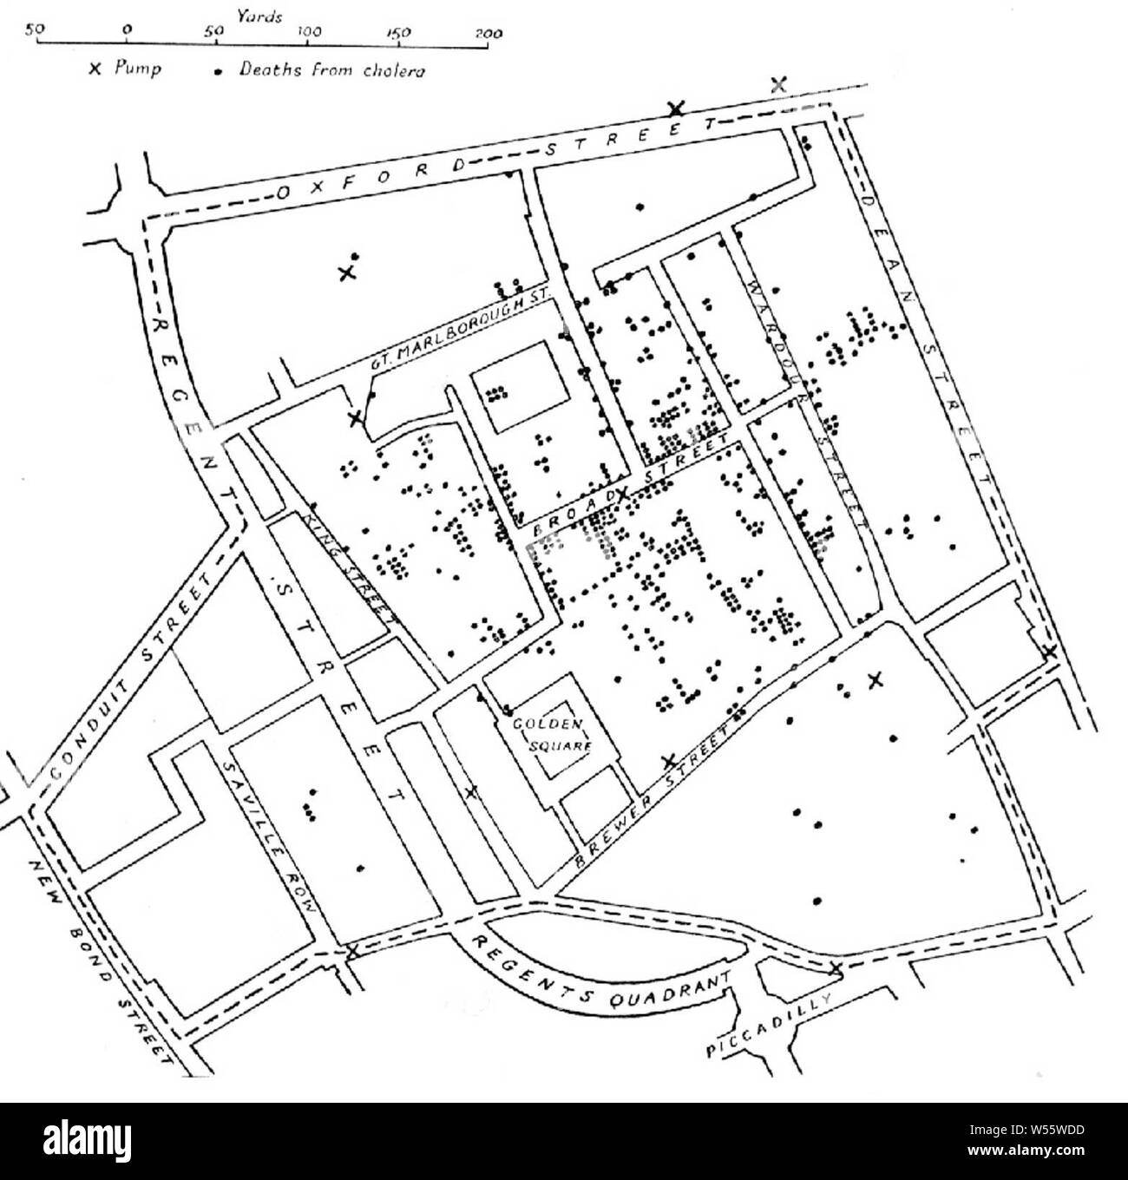
John snow spot Map
John Snow of England in his classic investigation of cholera epidemic in 1854 in the Golden Square district of London was able to focus attention on the common water pump in Broad street as the source of infection.
Snow was able to hypothesize that cholera was a water-borne disease, long before the birth of bacteriology

Slide 19
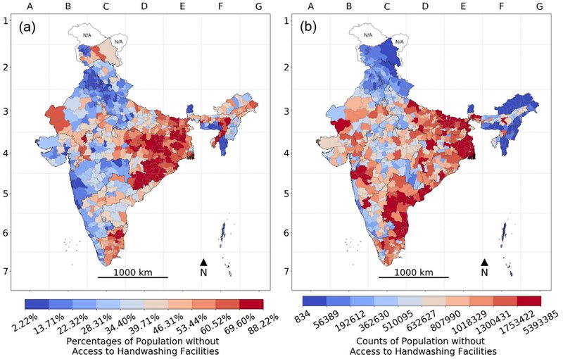

Slide 20
Another examples
Spot map by “place of employment” Maxey hypothesized a rodent reservoir for typhus fever in 1920s which led to the discovery that typhus fever was not a single disease entity, as it was earlier thought.
Evidence of case clustering based on sexual contact or blood product use provided the clue that AIDS (Acquired Immune Deficiency Syndrome) was an infectious disease.

Slide 21
Importance
These differences are determined by the agent, host and environmental factors.
The classic example of place-related diseases include yellow fever, schistosomiasis, sleeping sickness and endemic goitre.
There have also been studies on asthma, cancer, cardiovascular diseases, blood groups and abnormal haemoglobins by geographic location.
All diseases whether acute or chronic, communicable or non-communicable, show definite patterns of geographic distribution.
The clinician is also benefited from knowledge that a patient comes to him from a certain geographic area which is endemic for certain infrequent diseases such as yaws or leishmaniasis, as it helps him to focus attention on these diseases to which the patient may have been exposed.

Slide 22
Migration studies
Evaluate the role of the possible genetic and environmental factors in the occurrence of disease in a population.
There are marked geographic differences in the occurrence of a disease in two areas, area “A” and area “B”.
Let us assume that the environments in these two places are very different.
Does environmental differences in the two areas account for the variations in the occurrence of the disease.

Slide 23
Migration studies
Comparison of disease and death rates for migrants with those of their kin who have stayed at home.
This permits study of genetically similar groups but living under different environmental conditions or exposures. If the disease and death rates in migrants are like country of adoption over a period of time, the likely explanation would be change in the environment. A special case is the use of twins who have been exposed to different environments of migration.
Comparison of migrants with local population of the host country provides information on genetically different groups living in a similar environment.
If the migration rates of disease and death are similar to the country of origin, the likely explanation would be the genetic factors.

Slide 24
Migration studies
Men of Japanese ancestry living in USA experience a higher rate of coronary heart disease than do the Japanese in Japan. Japan has a higher rate for stomach cancer and a lower rate for colon cancer than the United States has. However, third-generation descendants of Japanese immigrants to USA have rates of stomach and colon cancer like those of the total US population.
These studies suggest that as the Japanese were probably adopting the American way of life, their susceptibility to coronary heart disease, gastric and colonic cancer was moving in the direction of that found in the Americans.
Migrant studies may also indicate the duration of residence necessary to acquire susceptibility to the disease in question by comparing groups that left home at different ages.
Studies of this kind provide a basis for further studies of specific environmental factors to which the migrants may have been exposed or of changes in their habits of life that may be of aetiological importance.

Slide 25
Migration study - defect
Migrant studies suffer from the usual defects of observational studies
Lack of random assignment to the groups under observation.
Migrants may be self-selected in that fit, vigorous and perhaps the temperamentally unstable are more likely to migrate.
The environmental factors may only act at a certain critical point or at a certain specific age.
If the incubation period of the disease is very long, migrants may not show any increased incidence or mortality from the disease for many years.

Slide 26
Person distribution - age
Age
Younger population
Middle age
Old age
All age groups
Bimodality
Bimodality is of special interest to epidemiologists. It indicates that the study material is not homogeneous, and that two distinct sets of causal factors might be operative, even though the clinical and pathological manifestations of the disease are the same at all ages.
(a) small numbers of observations are a frequent source of bimodality;
(b) the absence of bimodality does not signify that data have come from a homogeneous source.
Progressive increase in prevalence with advancing age may reflect a persistent and cumulative exposure to a causal agent or risk factor

Slide 27
Sex & Ethnicity
Basic biological differences between the sexes, including sex-linked genetic inheritance, and
Cultural and behavioural differences between the sexes
(e.g., smoking, automobile use, alcoholism) due to different roles in social setting.
It is the 4:1 male to female ratio in lung cancer that has helped to identify cigarette smoking as a causal factor.
Differences in disease occurrence have been noted between population subgroups of different racial and ethnic origin. These include tuberculosis, essential hypertension, coronary heart disease, cancer, and sickle cell anaemia. These differences, whether they are related to genetic or environmental factors, have been a stimulus to further studies.

Slide 28
Marital status
Mortality rates were always lower for married males and females than for the unmarried, of the same age and sex.
Marriages are selective with respect to the health status of persons, for those who are healthy are more likely to get married, with the result that the risk of dying is also less.
Besides, married persons are generally more secure and protected and they usually lead a more sober life than those who are unmarried.
The observation that cancer cervix is rare in nuns led to the hypothesis regarding marital status and cancer cervix. Further studies led to the suggestion that cancer cervix may be associated with multiple sexual contacts and promiscuity.

Slide 29
Occupation & Social class
Occupation may alter the habit pattern of employees e.g., sleep, alcohol, smoking, drug addiction, night shifts etc. It is obvious that persons working in particular occupations are exposed to particular types of risks.
Individuals in the upper social classes have a longer life expectancy and better health and nutritional status than those in the lower social classes.
Certain diseases (e.g., coronary heart disease, hypertension, diabetes) have shown a higher prevalence in upper classes than in the lower classes. Social class differences have also been observed in mental illness and utilization of medical and health care services.
Social classification varies from country to country. It has different meanings for different persons. Therefore associations of disease with social class vary according to one’s concept of social class.
Consequently, it is difficult to compare the results of studies in which social class has been used differently by different investigators.

Slide 30
Behavior & stress
The behavioural factors which have attracted the greatest attention are cigarette smoking, sedentary life, over-eating and drug abuse.
Mass movement of people, such as occurs in pilgrimages, which lends themselves to the transmission of infectious diseases such as cholera and diarrhoeal diseases, insect—borne and sexually transmitted diseases.
Stress has been shown to affect a variety of variables related to patients response, e.g., susceptibility to disease, exacerbation of symptoms, compliance with medical regimen, etc.

Slide 31
Migration
Human movement may be classified
(i) as short-term, long-term, and permanent
(ii) according to age, sex, education, occupation,
(iii) internal or external
(iv) urban versus rural, etc.
Migration has presented challenge to control/prevention of disease.

Slide 32

Measurement of disease
Available in terms of mortality, morbidity, disability, etc
Should be available for different subgroups
Morbidity has two aspects - incidence and prevalence
Incidence - “longitudinal” studies
Prevalence - “cross-sectional” studies.

Slide 33
Cross-sectional studies
Simplest form of an observational study.
It is based on a single examination of a cross-section of population at one point in time
Results of which can be projected on the whole population provided the sampling has been done correctly.
Cross-sectional study is also known as “prevalence study”.

Slide 34
Cross-sectional studies
More useful for chronic than short-lived diseases.
In a study of hypertension, we can also collect data during the survey about age, sex, physical exercise, body weight, salt intake and other variables of interest.
We can determine how prevention of hypertension is related to certain variables simultaneously measured.
Study tells us about the distribution of a disease in population rather than its aetiology.

Slide 35
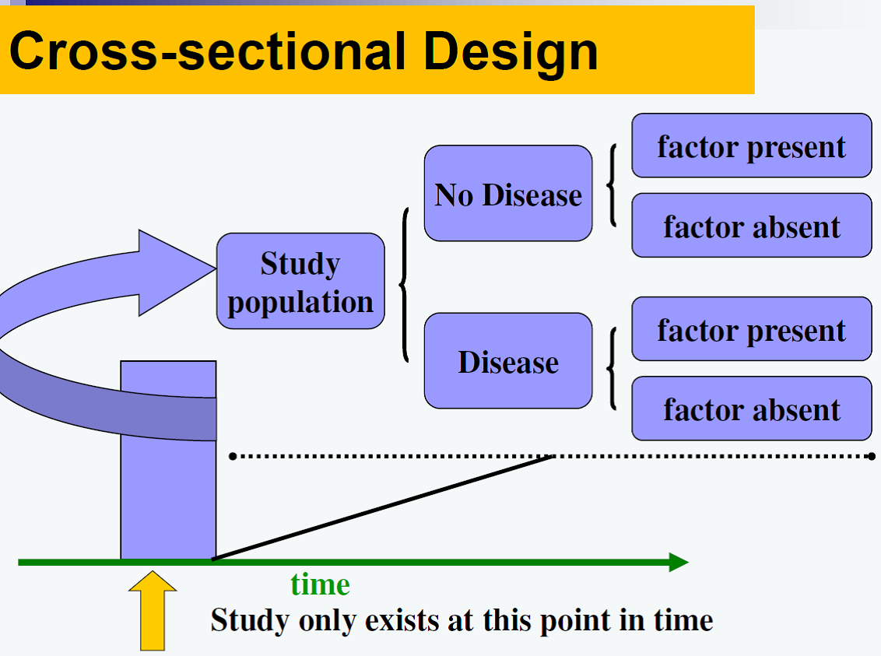
Limitations
Cannot establish causality
Selection bias
Information Bias
Measurement bias
Length biased sampling
Cases over-represented if illness has long duration,
Underrepresented if illness had short duration
Recall Bias
Information about the natural history of disease or about the rate of occurrence of new cases

Slide 36

Longitudinal studies
Observations are repeated in the same population over a prolonged period of time by means of follow-up examinations.
Cross-sectional studies - photograph, longitudinal studies - cine film.
Study the natural history of disease and its future outcome

Slide 37
Longitudinal studies
For identifying risk factors of disease,
For finding out incidence rale or rate of occurrence of new cases of disease in the community.
Longitudinal studies are difficult to organize and more time-consuming than cross-sectional studies.
Measurement can also be extended to health states and events.

Slide 38

Comparing known indices
The essence of epidemiology is to make comparisons and ask questions.
By making comparisons between different populations, and subgroups of the same population, it is possible to arrive at clues to disease aetiology.
We can also identify or define groups which are at increased risk for certain diseases.

Slide 39
Formulation of a hypothesis
A hypothesis is a supposition, arrived at from observation or reflection.
It can be accepted or rejected, using the techniques of analytical epidemiology.
An epidemiological hypothesis should specify the following:
The population - the characteristics of the persons to whom the hypothesis applies
The specific cause being considered
The expected outcome - the disease
The dose-response relationship - the amount of the cause needed to lead to a stated incidence of the effect
The time-response relationship - the time period that will elapse between exposure to the cause and observation of the effect.

Slide 40
Research question
Population / Patient
P
Intervention / exposure
I
Comparison
C
Outcome
O
Time
T
Setting
S

Slide 41
Uses of descriptive epidemiology
Provide data regarding the magnitude of the disease load and types of disease problems in the community in terms of morbidity and mortality rates and ratios
Provide clues to disease aetiology, and help in the formulation of an aetiological hypothesis.
Existence of a possible causal association between a factor and a disease is usually recognized in descriptive studies. Thus, if the disease is observed to be more frequent in a particular group than in others, hypotheses are formulated to explain the increased frequency.
Provide background data for planning, organizing and evaluating preventive and curative services,
They contribute to research by describing variations in disease occurrence by time, place and person,

Slide 42

Thanks

